Slide 1
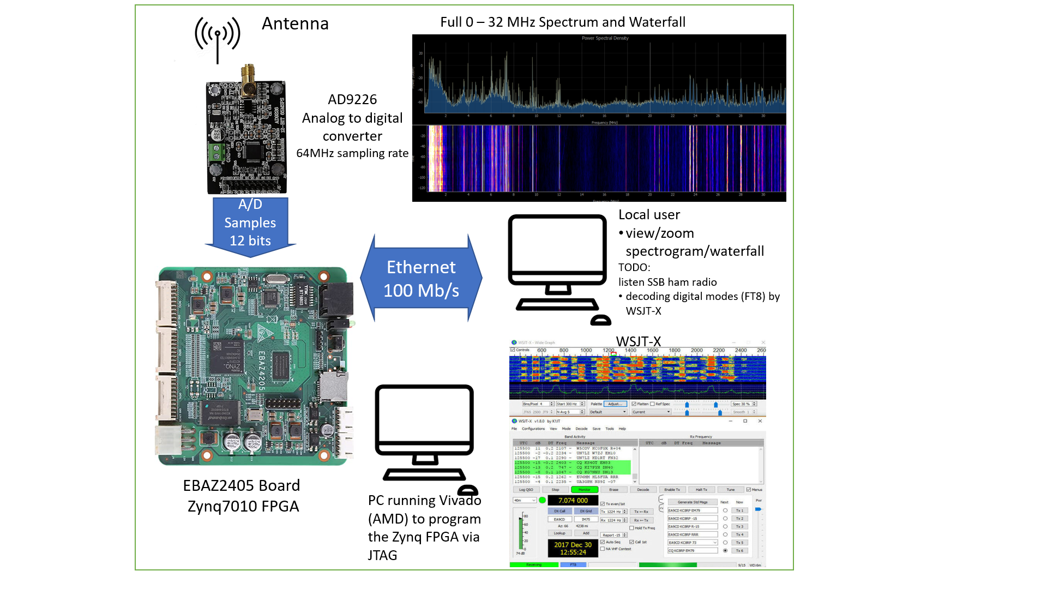

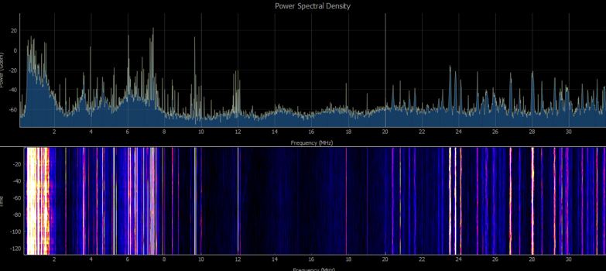
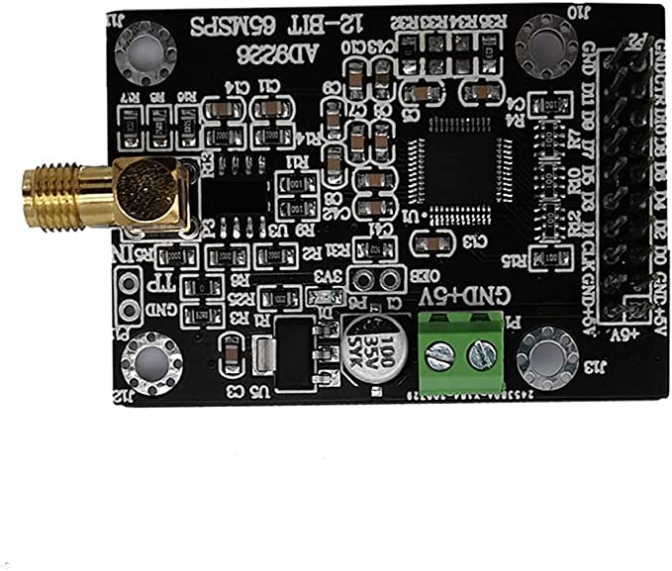

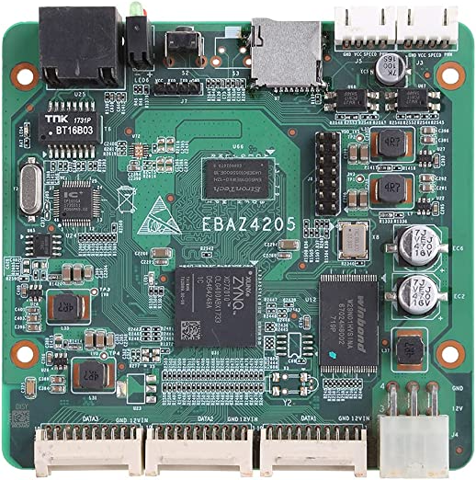
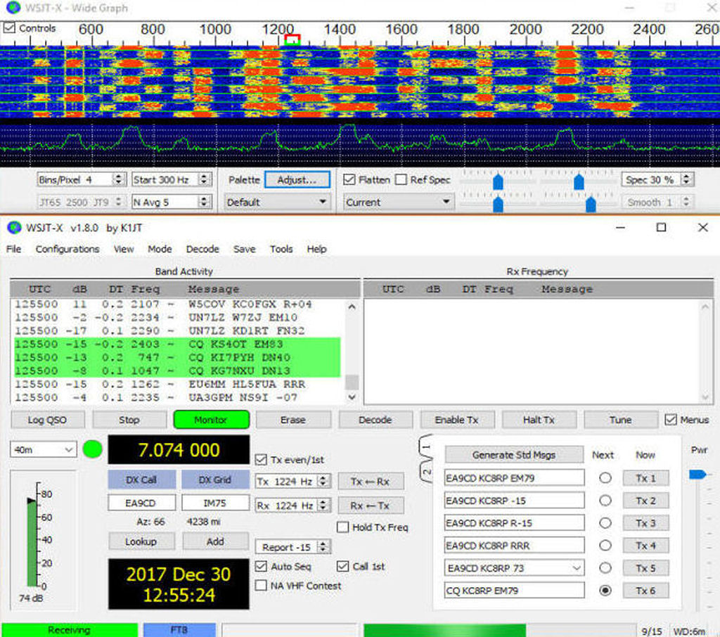
Antenna
Full 0 – 32 MHz Spectrum and Waterfall
AD9226
Analog to digital converter
64MHz sampling rate
A/D Samples
12 bits
Local user
view/zoom spectrogram/waterfall
TODO:
listen SSB ham radio
decoding digital modes (FT8) by WSJT-X
Ethernet 100 Mb/s
WSJT-X
EBAZ2405 Board
Zynq7010 FPGA
PC running Vivado (AMD) to program the Zynq FPGA via JTAG

Slide 2
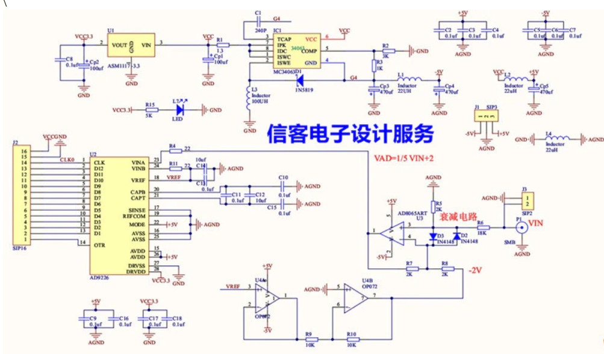

Slide 3
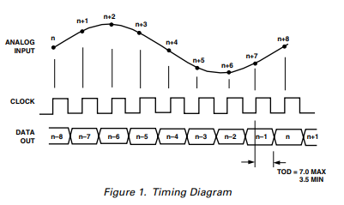
AD9226 output

Slide 4
Block diagram
DDC
Waterfall
0 – 1v
65MSps
256 KSps
A/D
DDC
Audio
DMA

Slide 5
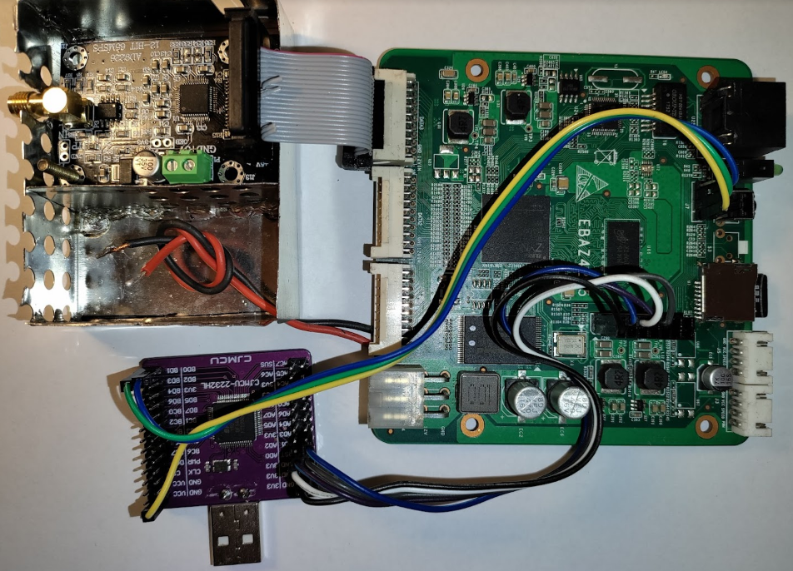
16 wires ADC <-> FPGA (PL)
EBAZ4205 board with Zynq-7000 (PS+PL)
Shielded ADC
Ethernet
UART
Shielded power supply filter (TODO)
JTAG
USB <-> JTAG
&
USB <-> UART

Slide 6
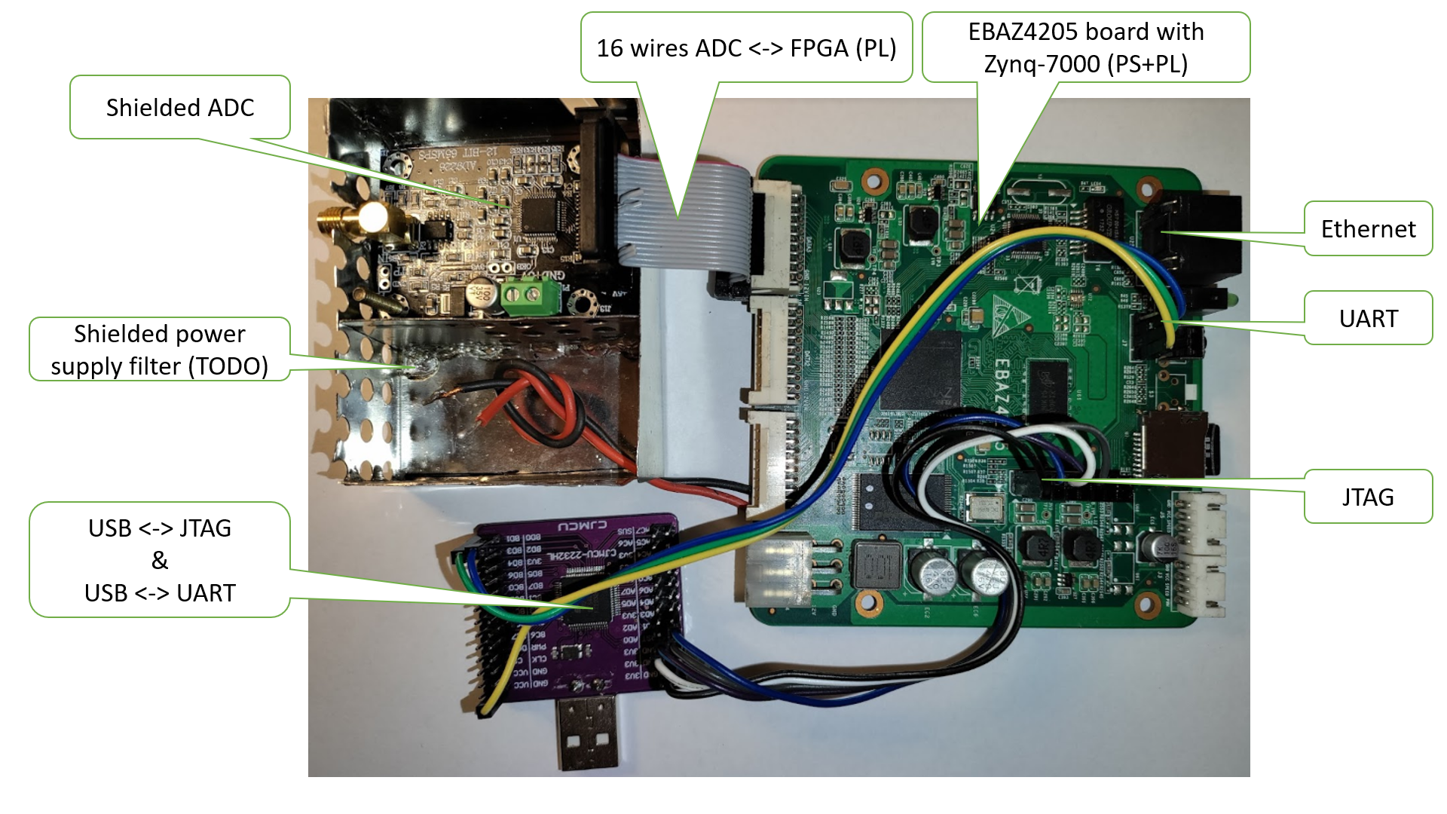

Slide 7
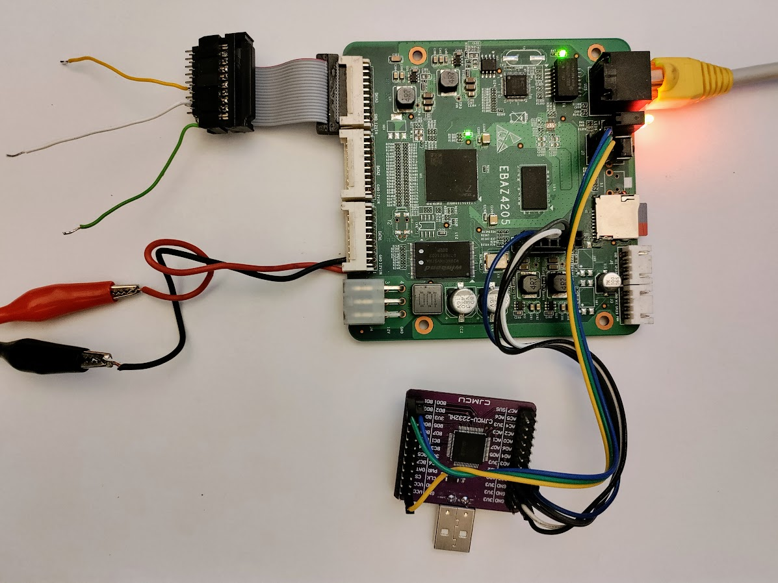
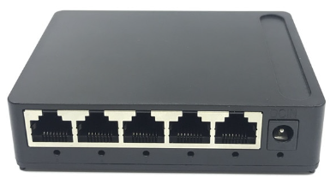
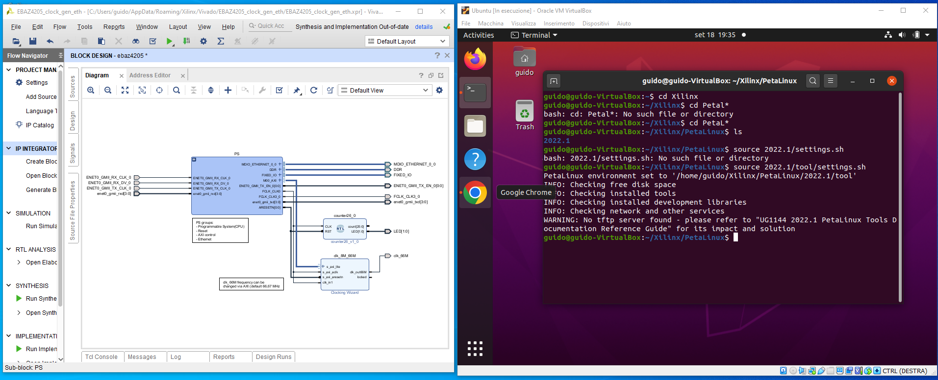
Test points
Ethernet
100 Mbits/sec
UART
100/1000 Mbits/sec
(option: Internet)
32GB SD
JTAG
12V 500mA
USB to
UART + JTAG
Ethernet
100 Mbits/sec
PC I7 10750
16 GB RAM – 2 TB SSD
USB
Windows 10 or 11
VIVADO 2021.2 for Windows
ORACLE VM VirtualBox 6.1.38
UBUNTU 20.04.1
PetaLinux Tools 2021.2

Slide 8
3 macro steps to design / test the Programmable Logic and the Linux / Standalone software
1) Set an initial basic block design on Vivado, prepare a Linux SD Card and first boot EBAZ4205
In PetaLinux:
Create a project
Configure it with the «Exported Hardware» (.xsa)
Build
Package (.wic)
In Vivado:
Create a basic block design
Generate bitstream (.bit)
Export hardware (.xsa)
In BalenaEtcher:
Flash the .wic package to a MicroSD (32GB)
On EBAZ4205:
Boot from MicroSD
Check if Ethernet is working
Start
2) Modify the block design on Vivado and test the results on EBAZ4205
In Vivado:
Modify the block design
Generate bitstream (.bit)
Convert .bit to .bin with bootgen
Send .bin to EBAZ4205 via JTAG
On EBAZ4205:
Check if the new block design is working as expected
Y
N
3) Modify/Debug the Standalone/Linux App on Vitis IDE and test the results on EBAZ4205
In Vitis:
Create/Modify an app
Debug it on EBAZ4205
Check if the App is working as expected
Y
N
End

Slide 9
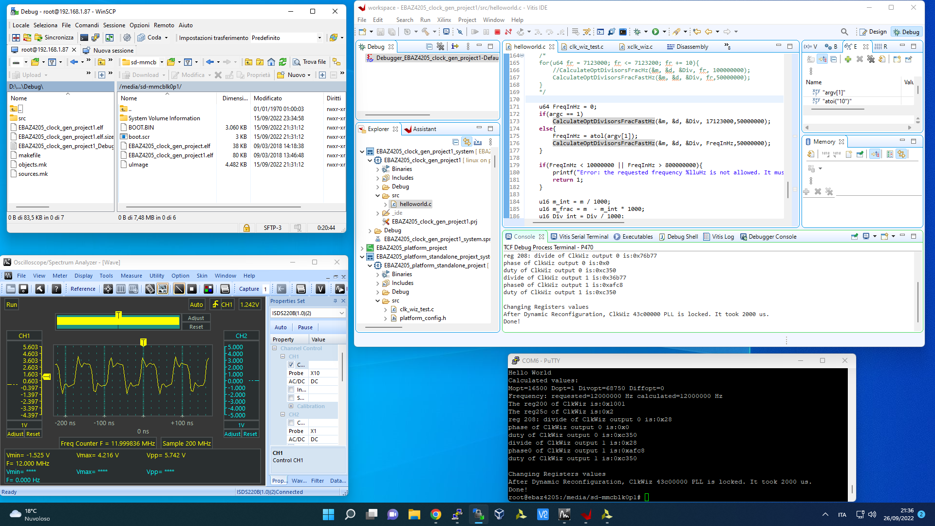
WinSCP:
Browse the Linux folders
Copy From/To Windows To/From Linux
Vitis IDE:
Debug / Run Linux Apps on EBAZ4205 via TCF (TCP port 1534)
Debug / Run Standalone Apps on EBAZ4205 via JTAG
Oscilloscope:
Examine hardware signals on testpoints
SSH (via IP) or TTY (via UART) EBAZ4205 Console:
Run Linux Apps
Configure Linux (Ethernet, Web Server, ALSA, …)

Slide 10
Zynq 7010
Programmable Logic
Zynq7010 PS (CPU)
 | Zoom
 | 1
 | 2
 | 4
 | 8
 | 16
 | 32
 | 64
 | 128
13 bits
64 MSps
Data
Capture
16384 x 32 bits
ADC
12 bits + OverRange
Sampler
13 bits – 64 MSps
Waterfall DDC
TCP Server
Ethernet
CIC
4-512
FIR
8
I&Q
X
CIC 64
Data
Capture Dual
2 x 2048 x 32 bits
Memory mapped I/O
X
CIC
CIC
64
FIR
8
Clocking Wizard
64MHz
DDS
Windows 10 PC
HPSDR
EXTIO
EBAZ4205 DLL
Ethernet

Slide 11
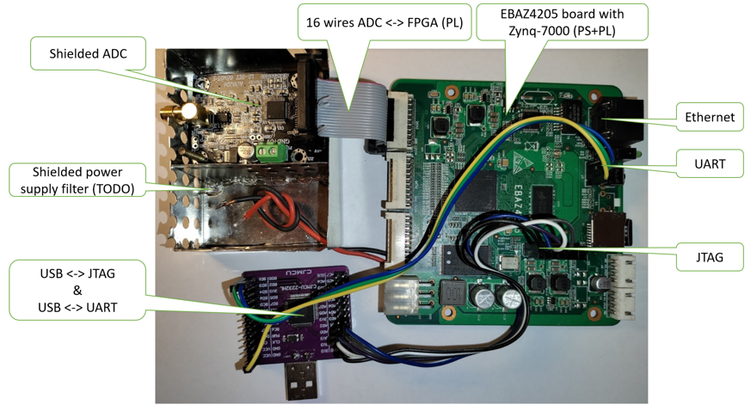
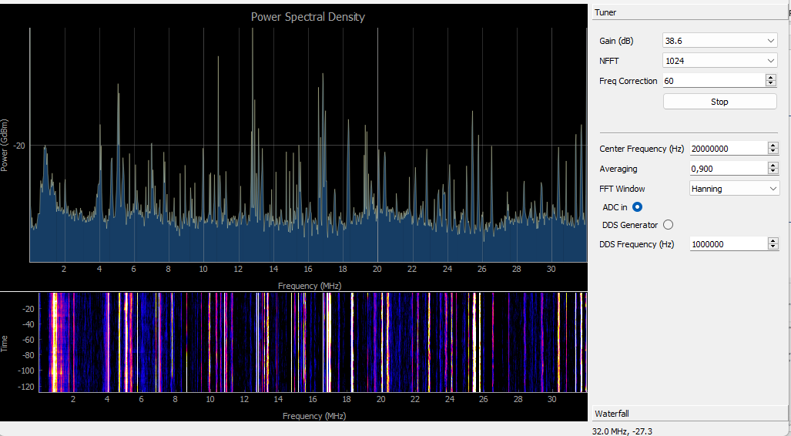
Zynq 7010
Programmable Logic
Zynq7010 PS (CPU)
13 bits
64 MSps
ADC
12 bits + OverRange
Sampler
13 bits
64 MSps
MUX
(switch)
Data
Capture
16384 x 32 bits
Windows 10 PC
TCP Server
SpectrumPy
Ethernet
Ethernet
Memory mapped I/O
RF test generator
100KHz-30MHz
64MHz
clock
Set Frequency

Slide 12
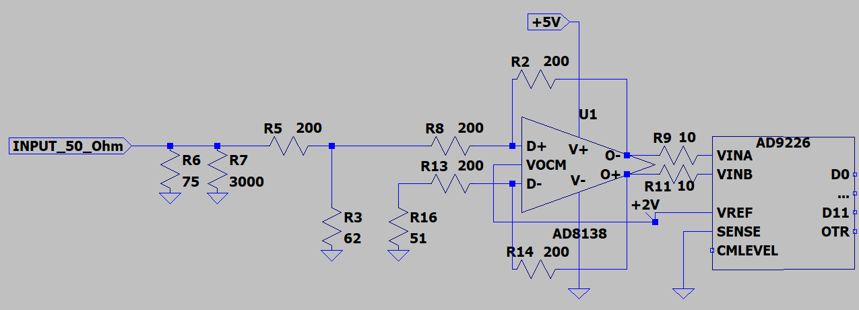
AD9226 board
Original schematic of the analog input
The overall amplification between VINA-VINB and INPUT_50_Ohm is approximatively:
200//62
-------------------- x (200/200 + 1) = 0,38 i.e. -8,4 dB
200 + 200//62
With SENSE = GND, the full scale between VINA and VINB is 2 Vpp
i.e.
VINA – VINB = +1V D11…D0=0xFFFFFF
VINA – VINB = 0V D11…D0=0x7FFFFF
VINA – VINB = -1V D11…D0=0x000000

Slide 13
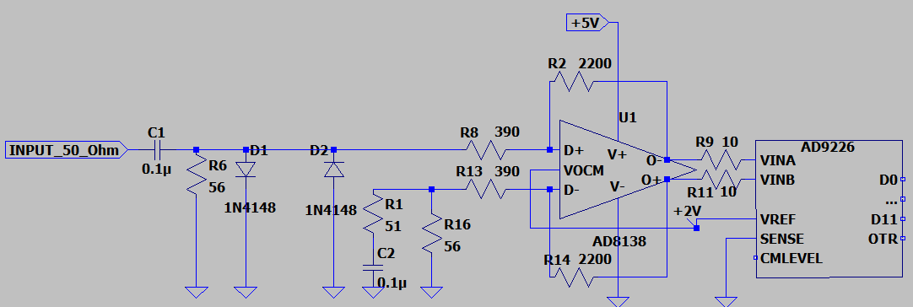
AD9226 board
Modified schematic of the analog input
The overall amplification between VINA-VINB and INPUT_50_Ohm is approximatively:
(2200/390 + 1) = 6,64 i.e. 16,5 dB
With SENSE = GND, the full scale between VINA and VINB is 2 Vpp
i.e.
VINA – VINB = +1V D11…D0=0xFFFFFF
VINA – VINB = 0V D11…D0=0x7FFFFF
VINA – VINB = -1V D11…D0=0x000000
16,5+8,4= 24,9dB better than the original

Slide 14
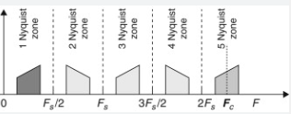
0 32 64 96 128 MHz

Slide 15
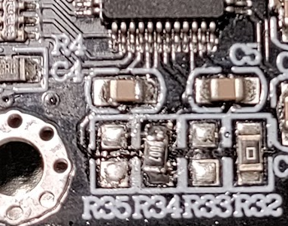
ADC9226 board
Change data outputs from Straight Binary to Two’s Complement
Two’s complement:
R35: not connected
R34: 10 KOhm
Straight Binary :
R35: 10 KOhm
R34: not connected

Slide 16
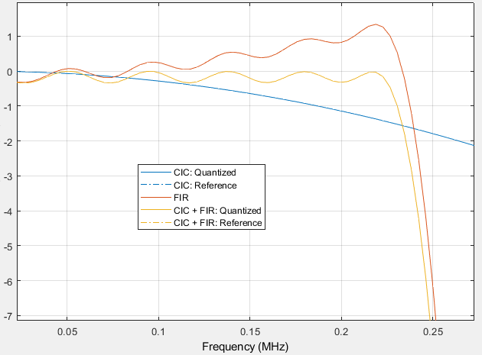
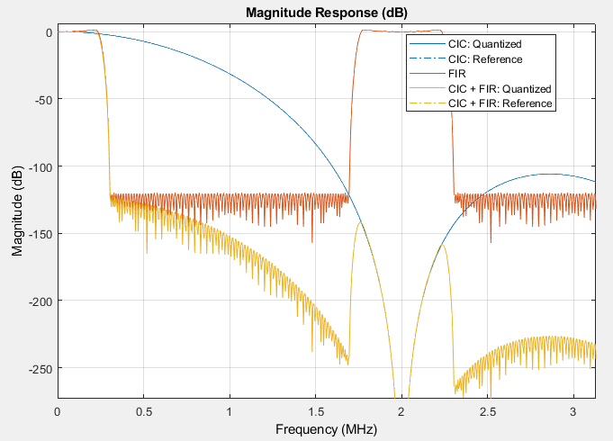
Filter Model
Bandwith can range from 1KHz to 2MHz changing decimation rate (R) only
Fs=64MHz Fs/R Fs/R .
CIC filter
R=4…8192 decimation
N=8 stages
FIR filter
L=110 coefficients
R | Bandwidth = Fs/R * 0.25 (Hz) | Fs/R (Hz) | Example
4 | 2M | 16M | Spectrum
8 | 1M | 8M | Spectrum
16 | 0.5M | 4M | Spectrum
32 | 0.25M | 2M | Spectrum
64 | 0.125M | 1M | Spectrum
128 | 62K | 0.5M | Spectrum
256 | 30K | 0.25M | AM / Spectrum
512 | 15K | 0.125M | AM
1024 | 8K | 62K | DSB / AM
2048 | 4K | 30K | FT8 / USB / LSB
4096 | 2K | 15K | FT8 / CW
8192 | 1K | 8K | WSPR / CW
CIC compensation
CIC compensation by FIR is indipendent from R (for R>=4)
High (>120dB) stopband attenuation

